Slide 1
Dynamic Programming
Matrix Chain Multiplication
Longest Common Subsequence

Slide 2
Matrix Chain Multiplication

Slide 3
Matrix Chain Multiplication
Let us consider 4 matrices A1, A2, A3 and A4.
M = A1 X A2 X A3 X A4
M=
1 | 1
1 | 1
1 | 1
1 | 1 | 1
1 | 1 | 1
1 | 1
1 | 1
1 | 1 | 1
1 | 1 | 1
Matrix | A1 | A2 | A3 | A4
Dimension | (2,3) | (3,2) | (2,2) | (2,3)

Slide 4
Multiplication Order
For matrix multiplication the matrix dimensions must agree
We can multiply matrices in different ways
M= (A1 X A2) X (A3 X A4)
= A12 X A34
= A14
OR
M= (((A1 X A2) X A3 ) X A4)
= ((A12 X A3 ) X A4)
= (A13 X A4)
= A14

Slide 5
Multiplication Order
Question:
How many multiplication operations are needed for both the cases?
Let’s check using the given example

Slide 6
Lets check out the first ordering
Total number of multiplications:
36
M= (A1 X A2) X (A3 X A4)
M=
=
1 | 1
1 | 1
1 | 1
1 | 1 | 1
1 | 1 | 1
1 | 1
1 | 1
1 | 1 | 1
1 | 1 | 1
1X1+1X1+1X1 | 1X1+1X1+1X1
1X1+1X1+1X1 | 1X1+1X1+1X1
1X1+1X1 | 1X1+1X1 | 1X1+1X1
1X1+1X1 | 1X1+1X1 | 1X1+1X1
2 | 2 | 2
2 | 2 | 2
3X2+3X2 | 3X2+3X2 | 3X2+3X2
3X2+3X2 | 3X2+3X2 | 3X2+3X2
3 | 3
3 | 3
12 | 12 | 12
12 | 12 | 12

Slide 7
Lets check out the second ordering
Total number of multiplications:
32
M= (((A1 X A2) X A3 ) X A4)
M=
1 | 1
1 | 1
1 | 1
1 | 1 | 1
1 | 1 | 1
1 | 1
1 | 1
1 | 1 | 1
1 | 1 | 1
1X1+1X1+1X1 | 1X1+1X1+1X1
1X1+1X1+1X1 | 1X1+1X1+1X1
1 | 1
1 | 1
1 | 1 | 1
1 | 1 | 1
3 | 3
3 | 3
1 | 1
1 | 1
1 | 1 | 1
1 | 1 | 1
3X1+3X1 | 3X1+3X1
3X1+3X1 | 3X1+3X1
1 | 1 | 1
1 | 1 | 1
6 | 6
6 | 6
1 | 1 | 1
1 | 1 | 1
6X1+6X1 | 6X1+6X1 | 6X1+6X1
6X1+6X1 | 6X1+6X1 | 6X1+6X1
12 | 12 | 12
12 | 12 | 12

Slide 8


Another Question (similar to the earlier one)
How many multiplication operations are needed for the given matrices when you multiply them in the given order?
No_Of_Mults

Slide 9
Matrix | A1 | A2 | A3 | A4
Dimension | (2,3) | (3,2) | (2,2) | (2,3)
No_Of_Mults ((A1 X A2) X (A3 X A4))
P0
P1
P2
P3
P4
36
No_Of_Mults ((A1 X A2) X (A3 X A4))
2X2X3+12+12=36
12
P0P2P4
12
No_Of_Mults ((A1 X A2))
No_Of_Mults ( (A3 X A4))
2X3X2+0+0=12
2X2X3+0+0=12
P0P1P2
P2P3P4
0
0
0
0
No_Of_Mults (A1)
No_Of_Mults (A2)
No_Of_Mults ( A3)
No_Of_Mults ( A4)
0
0
0
0

Slide 10
P0
P1
P2
P3
P4
P5
P6
15,125
P0P3P6=
30X5X25=
3750
7875
3500
(A1(A2 A3))
((A4A5)A6)
P0P1P3=
30X35X5=
5250
P3P5P6=
5X20X25=
2500
0
0
2625
1000
A6
A1
(A2 A3)
(A4 A5)
P1P2P3=
35X15X5=
2625
P3P4P5=
5X10X20=
1000
0
0
0
0
A2
A3
A4
A5

Slide 11
Now you try !
M ((((A1 X A2) X A3 ) X A4))
= number of multiplication operations required to multiply (((A1 X A2) X A3 ) X A4)
Matrix | A1 | A2 | A3 | A4
Dimension | (2,3) | (3,2) | (2,2) | (2,3)
P0
P1
P2
P3
P4

Slide 12
We were learning Dynamic Programming Right?
Let us see what the problem was
You are given matrices A1, A2, … ,An
What is the minimum number of multiplications you need to get the final matrix
(And how will you keep the matrix multiplication order to get that minimum number ?)
(More simply – how will you place your brackets ?)

Slide 13
The Bottom Up Approach
Build up the base cases.
Construct the other cases from the base cases.
Now let us observe something:

Slide 14
N(A1A2A3A4)
N(1,4)
Length=4
N(1,1)
N(2,4)
N(1,2)
N(3,4)
N(1,3)
N(4,4)
Length=1
Length=3
Length=2
Length=2
Length=3
Length=1
N(2,2)
N(3,4)
N(2,3)
N(4,4)
N(1,1)
N(2,2)
N(1,1)
N(2,3)
N(3,3)
N(4,4)
N(1,2)
N(3,3)
Length=1
Length=2
Length=1
Length=1
Length=1
Length=1
Length=1
Length=2
Length=1
Length=2
Length=2
Length=1
N(3,3)
N(4,4)
N(2,2)
N(3,3)
N(2,2)
N(3,3)
N(1,1)
N(2,2)
Length=1
Length=1
Length=1
Length=1
Length=1
Length=1
Length=1
Length=1

Slide 15
The Bottom Up Approach
We need to call recursive functions for single matrices (A11)
Then we need to call recursive functions for consecutive two matrices (A1A2)
Then we need to call recursive functions for consecutive three (A1 A2 A3)
And so on….

Slide 16
The Bottom Up Approach
j
i
1
2
3
4
A(1,4)
1
Length=4
Length=3
A(1,3)
A(2,4)
2
Length=2
Length=1
A(1,1)
A(2,2)
3
A(1,2)
A(2,3)
A(3,4)
A(3,3)
A(4,4)
4

Slide 17
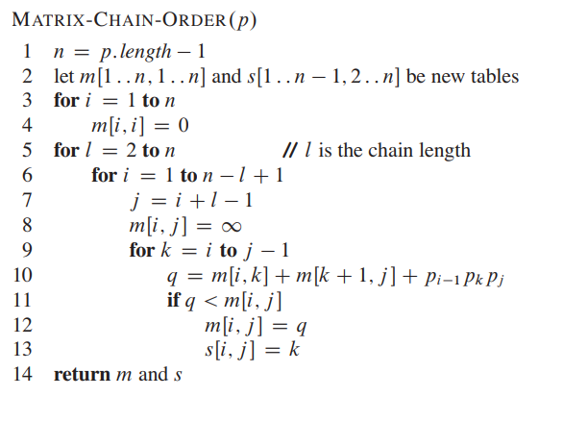
The Bottom Up Approach (as per Cormen’s book)
// for row number
// for column number
// for multiplication combination

Slide 18
Now let us simulate
j
i
1
2
3
4
First let us fill up the base cases
(i.e cases with length/number of matrices=1)
0
1
0
l=1
2
0
3
0
4

Slide 19
From the base cases of length 1 we will make the cases of length 2.
Matrix | A1 | A2 | A3 | A4
Dimension | (5,4) | (4,6) | (6,2) | (2,7)
P0
P1
P2
P3
P4
j
N[1][2]
N[1][1]+N[2][2]+P0P1P2
i
1
2
3
4
0 + 0 + 5X4X6
0
120
120
1
N[2][3]
N[2][2]+N[3][3]+P1P2P3
0
48
0 + 0 + 4X6X2
2
48
0
84
3
N[3][4]
N[3][3]+N[4][4]+P2P3P4
0 + 0 + 6X2X7
0
84
4

Slide 20
From the base cases of length 1 we will make the cases of length 2.
Matrix | A1 | A2 | A3 | A4
Dimension | (5,4) | (4,6) | (6,2) | (2,7)
P0
P1
P2
P3
P4
N[1][1]+N[2][3]+P0P1P3
j
N[1][3]
i
1
2
3
4
N[1][2]+N[3][3]+P0P2P3
0
120
88
1
0 +48 + 5X4X2
0
48
120+0+5X6X2
2
0
84
88
3
180
0
4
88

Slide 21
Matrix | A1 | A2 | A3 | A4
Dimension | (5,4) | (4,6) | (6,2) | (2,7)
From the base cases of length 1 we will make the cases of length 2.
You do this one now!
P0
P1
P2
P3
P4
j
N[2][2]+N[3][4]+P1P2P4
i
1
2
3
4
N[2][4]
0
120
88
N[2][3]+N[4][4]+P1P3P4
1
0 +84 + 4X6X7
0
48
104
2
48+0+ 4X2X7
0
84
3
252
0
104
4
104

Slide 22
Matrix | A1 | A2 | A3 | A4
Dimension | (5,4) | (4,6) | (6,2) | (2,7)
From the base cases of length 1 we will make the cases of length 2.
Do this one as well
P0
P4
P1
P2
P3
j
N[1][4]= min{ N[1]}[1]+N[2][4]+5X4X7,
N[1][2]+N[3][4]+5X6X7,
N[1][3]+N[4][4]+5X2X7
}
i
1
2
3
4
0
120
88
158
1
N[1][4]= min{ 0 + 104+ 140,
120+84+210,
88+0+70}
0
48
104
2
0
84
N[1][4]= min{ 0 + 104+ 140=244,
414,
158}
3
0
4
N[1][4]= 158

Slide 23
Keeping track of the splits (Lets denote it using k)
j
1
2
3
4
i
0
1
For the base cases k=0, as no splits
0
2
0
3
0
4

Slide 24
From the base cases of length 1 we will make the cases of length 2.
Matrix | A1 | A2 | A3 | A4
Dimension | (5,4) | (4,6) | (6,2) | (2,7)
k
P0
P1
P2
P3
P4
j
N[1][2]
N[1][1]+N[2][2]+P0P1P2
i
1
2
3
4
0 + 0 + 5X4X6
0
120
k
1
120
1
N[2][3]
N[2][2]+N[3][3]+P1P2P3
0
48
0 + 0 + 4X6X2
2
2
k
48
0
84
3
N[3][4]
N[3][3]+N[4][4]+P2P3P4
3
0 + 0 + 6X2X7
0
84
4

Slide 25
From the base cases of length 1 we will make the cases of length 2.
Matrix | A1 | A2 | A3 | A4
Dimension | (5,4) | (4,6) | (6,2) | (2,7)
k
P0
P1
P2
P3
P4
N[1][1]+N[2][3]+P0P1P3
j
N[1][3]
i
1
2
3
4
N[1][2]+N[3][3]+P0P2P3
0
120
88
k
1
1
1
0 +48 + 5X4X2
0
48
120+0+5X6X2
2
2
0
84
88
3
3
180
0
4
88

Slide 26
Matrix | A1 | A2 | A3 | A4
Dimension | (5,4) | (4,6) | (6,2) | (2,7)
From the base cases of length 1 we will make the cases of length 2.
You do this one now!
P0
P1
P2
P3
P4
k
j
N[2][2]+N[3][4]+P1P2P4
i
1
2
3
4
N[2][4]
0
120
88
N[2][3]+N[4][4]+P1P3P4
1
k
1
2
1
1
0 +84 + 4X6X7
0
48
104
2
2
48+0+ 4X2X7
2
3
0
84
3
252
3
0
104
4
104

Slide 27
Matrix | A1 | A2 | A3 | A4
Dimension | (5,4) | (4,6) | (6,2) | (2,7)
From the base cases of length 1 we will make the cases of length 2.
k
Do this one as well
P0
P4
P1
P2
P3
j
N[1][4]= min{ N[1][1]+N[2][4]+5X4X7,
N[1][2]+N[3][4]+5X6X7,
N[1][3]+N[3][4]+5X2X7}
k
i
1
2
3
4
0
120
88
158
1
k
1
1
3
N[1][4]= min{ 0 + 104+ 140,
120+84+210,
88+0+70}
0
48
104
2
2
3
0
84
N[1][4]= min{ 0 + 104+ 140=244,
414,
158}
3
3
0
4
N[1][4]= 158

Slide 28
Take away so far
Lengthwise cases are produced
We have seen how the equation works
We have understood the direction in which the tables are filled.
Lets write the pseudocode

Slide 29
The final k table
j
i
1
2
3
4
1
1
3
1
2
3
2
3
3
4

Slide 30
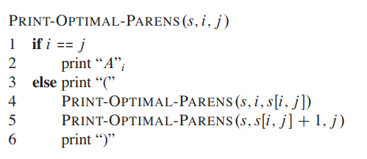
Printing the brackets
j
i
1
2
3
4
1
1
3
1
2
3
2
3
3
4
((A1(A2A3))A4)

Slide 31
Dynamic Programming
i=1
J=4
Print (1,4)
1. (
) .10
i=1
J=3
i=4
J=4
Print (1,s (1,4))
Print (s [1,4]+1,4)
Print (1,3)
Print (4,4)
9. A4
2. (
) .8
i=1
J=1
i=2
J=3
Print (1,s (1,3))
Print (s [1,3]+1,3)
((A1(A2A3))A4)
Print (1,1)
Print (2,3)
3. A1
4. (
) .7
i=3
J=3
i=2
J=2
Print (2,s (2,3))
Print (s [2,3]+1,3))
Print (2,2)
Print (3,3)
5. A2
6. A3
Slide Courtesy: Showrav Ghosh (23-50660-1)

Slide 32

Try out this one (on paper)

Slide 33
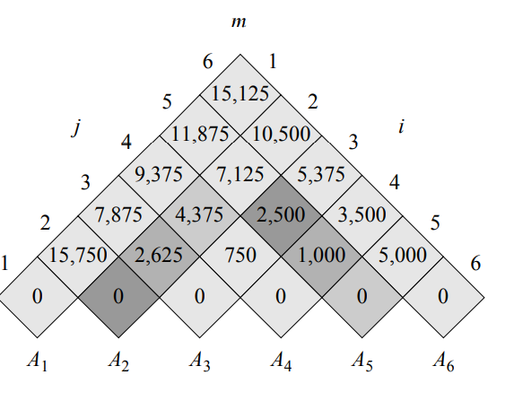
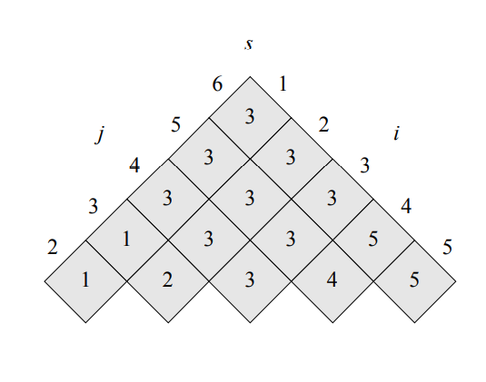

Slide 34
Thank You

